Slide 1
Multi-Task Deep Neural Networks for Natural Language Understanding
Xiaodong Liu∗1 , Pengcheng He∗2 , Weizhu Chen2 , Jianfeng Gao1
1 Microsoft Research 2 Microsoft Dynamics 365 AI

Slide 2
Why multi-task learning is needed?
Intuition: it is easier for a person who knows how to ski to learn skating than the one who does not.
➔ it is useful for multiple (related) tasks to be learned jointly so that the knowledge learned in one task can benefit other tasks
Reason why MTL is needed
supervised learning: requires large amounts of task-specific labeled data
regularization effect via alleviating overfitting to a specific task → universal representation

Slide 3
What is different between MTL and LM
language model pretraining has shown to be effective for learning universal language representations by leveraging large amounts of unlabeled data.
ELMo, GPT, BERT, …
➔ Combine these two to improve text representation to boost various task in NLU

Slide 4
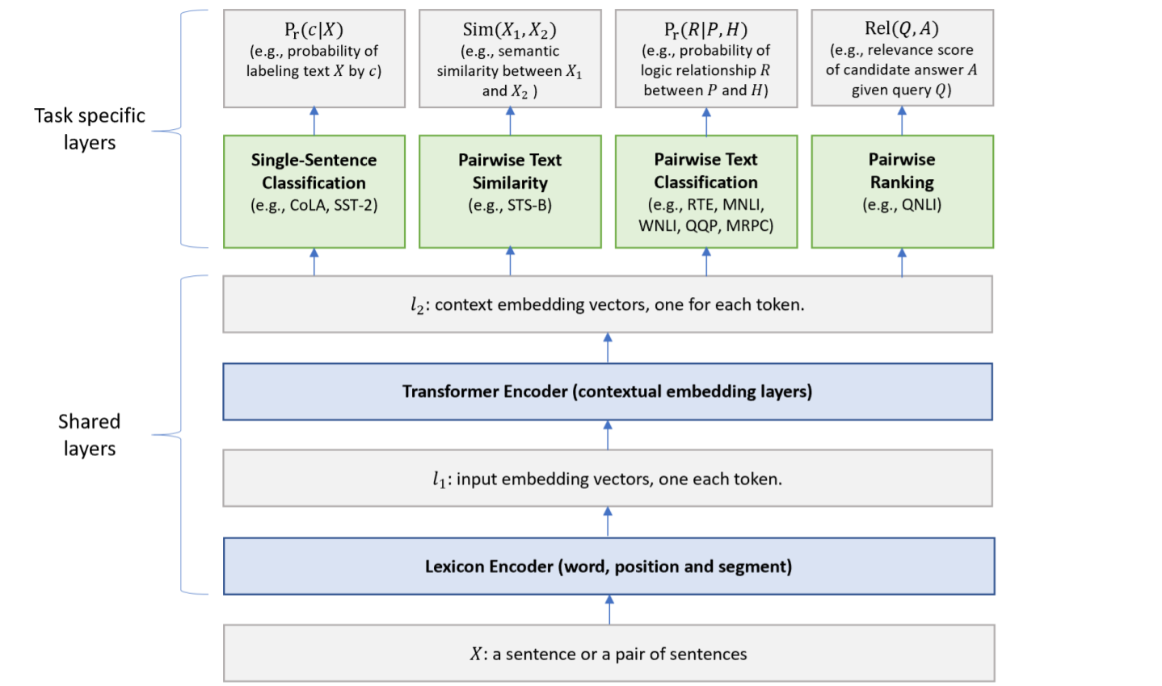
Combination of LM and MTL
Use BERT as its shared text encoding layers.
the top layers are task-specific, combining different types of NLU tasks
Notes:
MT-DNN is trained in two stages: pre-training and fine-tuning. Unlike BERT, MT-DNN uses MTL in the finetuning stage with multiple task-specific layers in its model architecture.

Slide 5
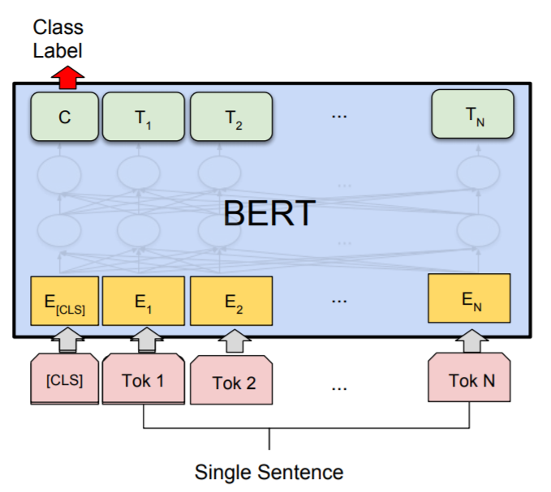
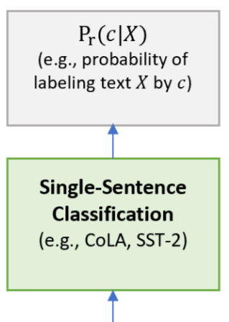

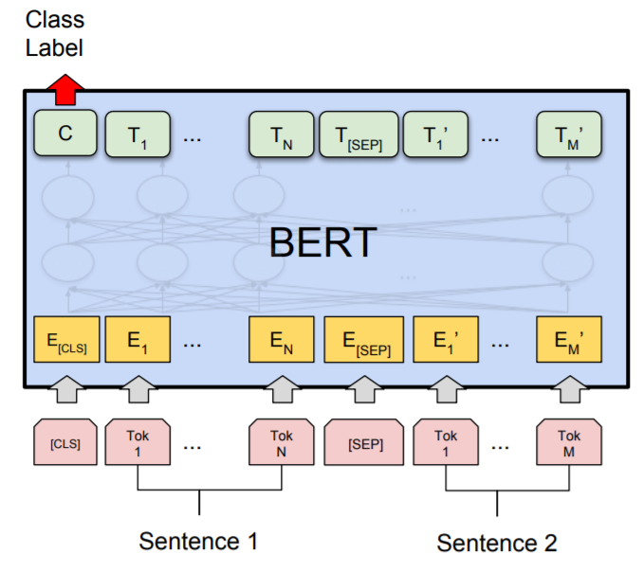
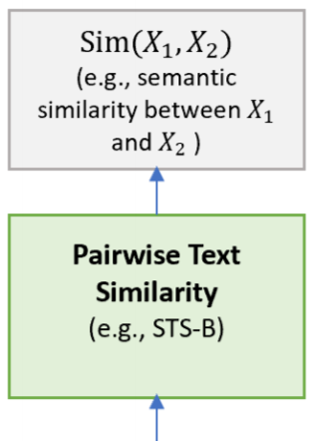

Objectives for each tasks
Contextual representation of [CLS] can be viewed as the semantic representation of input sentence X
Sigmoid function
Notes:
MT-DNN is trained in two stages: pre-training and fine-tuning. Unlike BERT, MT-DNN uses MTL in the finetuning stage with multiple task-specific layers in its model architecture.

Slide 6
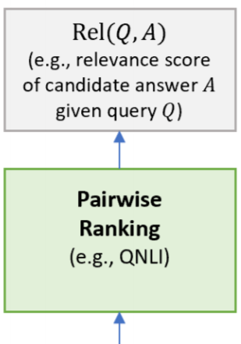

Objectives for each tasks
Sigmoid function
rank all of its candidate answers based on their relevance scores Rel (Q, A)
Notes:
MT-DNN is trained in two stages: pre-training and fine-tuning. Unlike BERT, MT-DNN uses MTL in the finetuning stage with multiple task-specific layers in its model architecture.

Slide 7
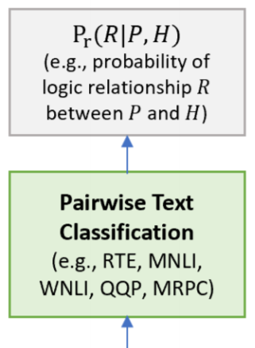
Objectives for each tasks
Stochastic Answer Networks
Considering multiple steps of reasoning
Q: What collection does the V&A Theator & Performance galleries hold?
P: The V&A Theator & Performance galleries opened in March 2009. ... They hold the UK’s biggest national collection of material about live performance.
Notes:
MT-DNN is trained in two stages: pre-training and fine-tuning. Unlike BERT, MT-DNN uses MTL in the finetuning stage with multiple task-specific layers in its model architecture.

Slide 8
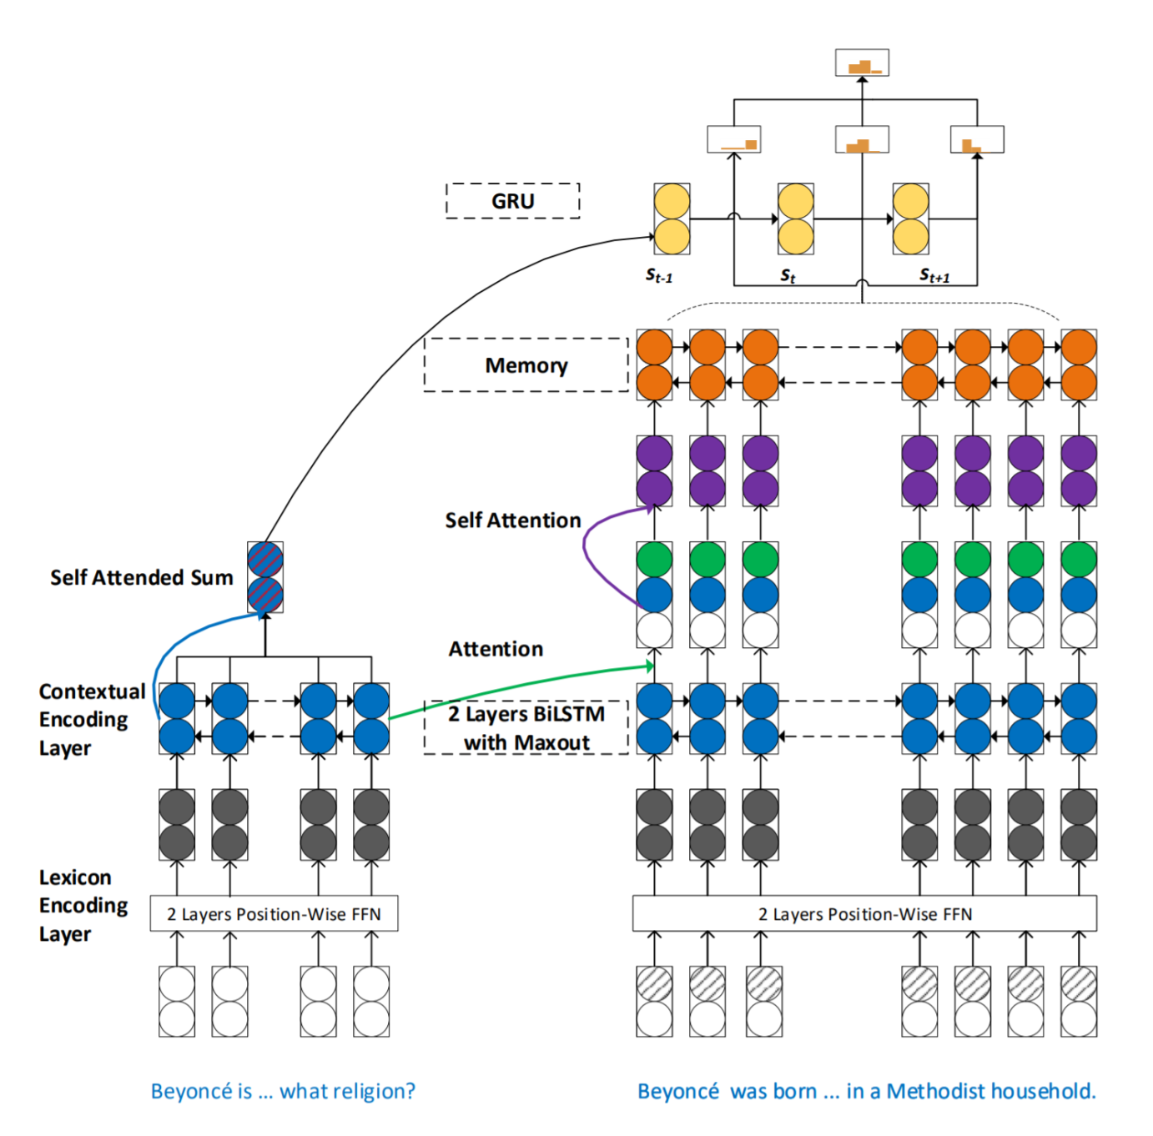
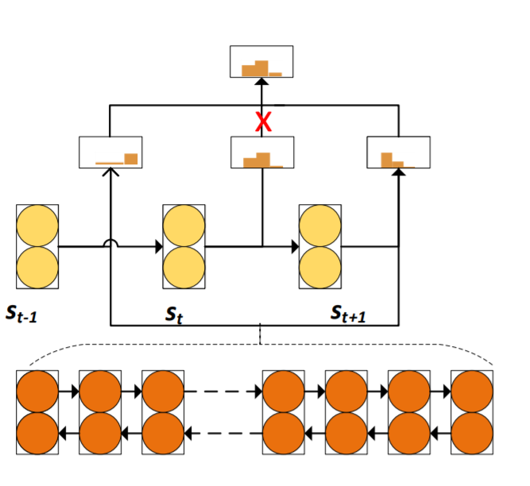
Objectives for each tasks
stochastic prediction dropout
Stochastic Answer Networks
Considering multiple steps of reasoning
Notes:
MT-DNN is trained in two stages: pre-training and fine-tuning. Unlike BERT, MT-DNN uses MTL in the finetuning stage with multiple task-specific layers in its model architecture.

Slide 9
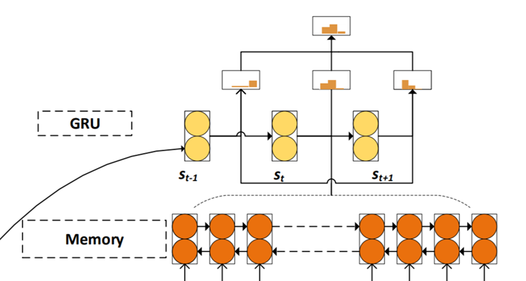

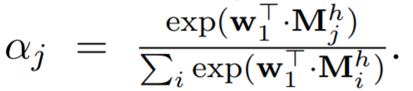




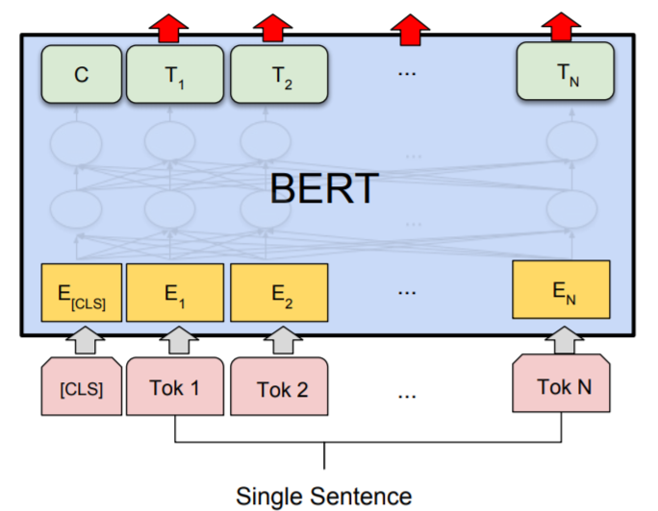
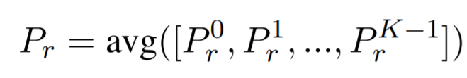
Objectives for each tasks
Stochastic Answer Networks
Considering multiple steps of reasoning
Notes:
MT-DNN is trained in two stages: pre-training and fine-tuning. Unlike BERT, MT-DNN uses MTL in the finetuning stage with multiple task-specific layers in its model architecture.

Slide 10
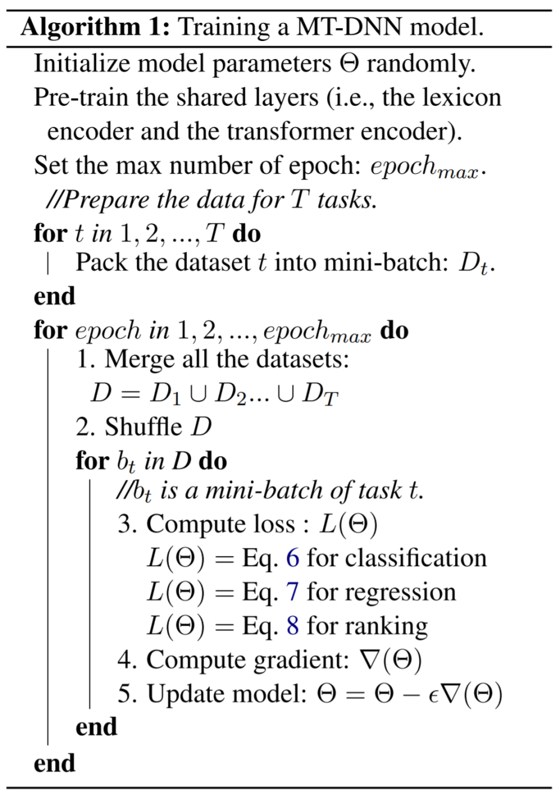


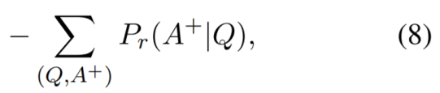
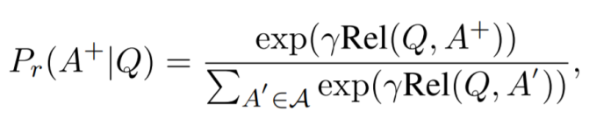
Training Procedure
masked language modeling
next sentence prediction.
contains positive, negative examples
Notes:
MT-DNN is trained in two stages: pre-training and fine-tuning. Unlike BERT, MT-DNN uses MTL in the finetuning stage with multiple task-specific layers in its model architecture.

Slide 11
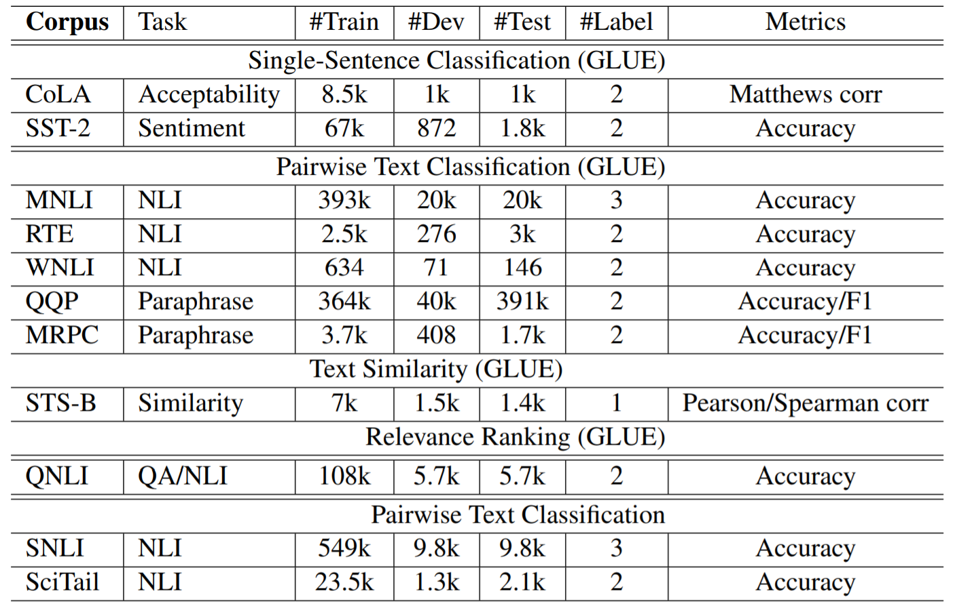
Evaluation Tasks
Notes:
CoLA – gramatically right
SST-2 – movie sentiment
RTE, MNLI – language inference task
QQP, MRPC – paraphrasing, simantically equal
QNLI – rank candidate in order of relevance to the query

Slide 12
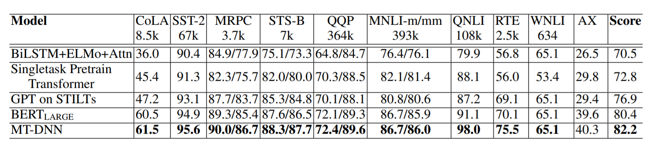
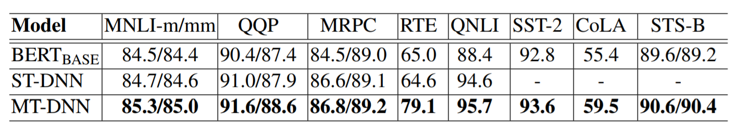
Evaluation Results - GLUE

Slide 13
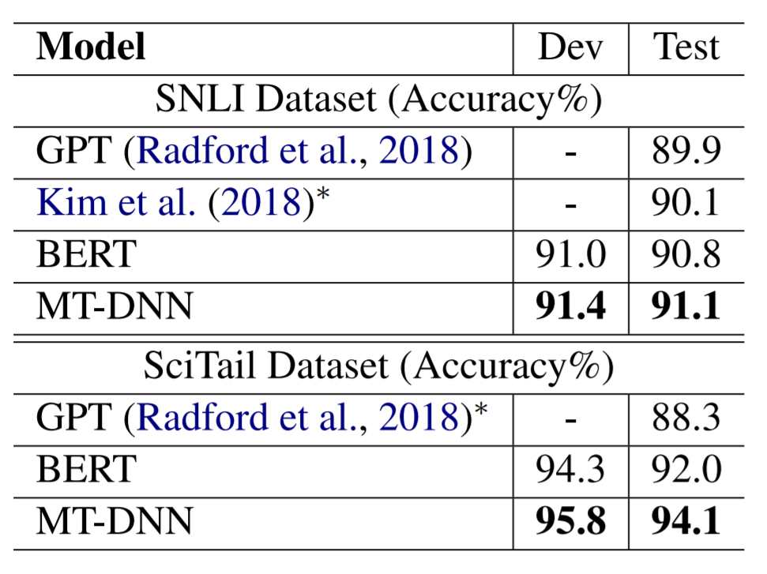
Evaluation Results - SNLI and SciTail

Slide 14
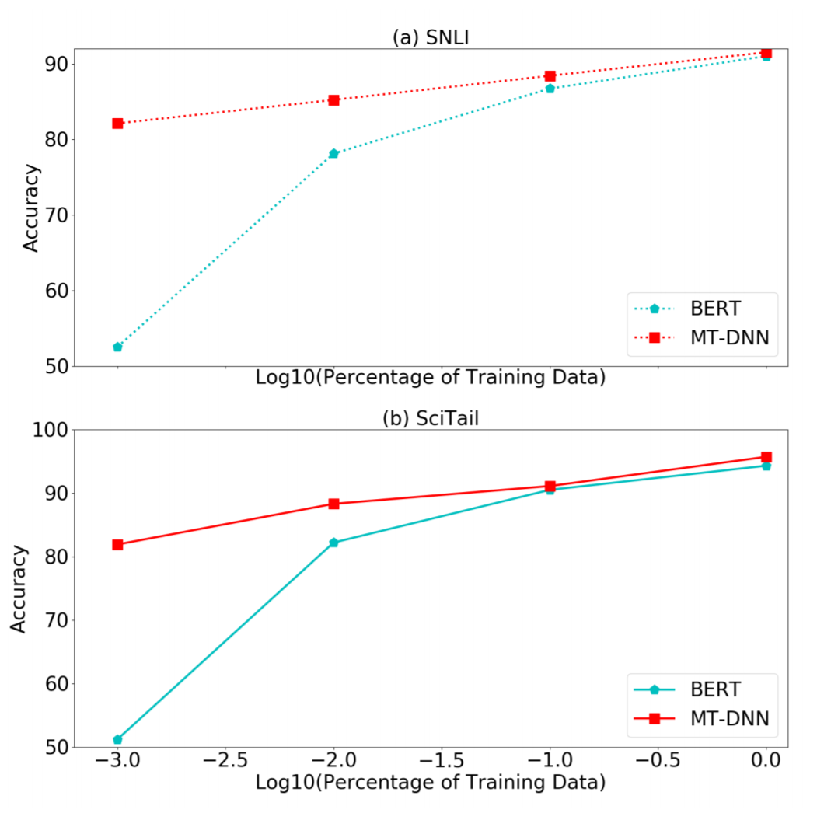
Domain Adaptation Results

Slide 15
Conclusion
combine multi-task learning and language model pre-training for language representation learning
new state-of-the-art results on ten NLU tasks across three popular benchmarks: SNLI, SciTail, and GLUE
exceptional generalization capability in domain adaptation experiments

Slide 16
Future Works
deeper understanding of model structure sharing in MTL
more effective training method that leverages relatedness among multiple tasks
ways of incorporating the linguistic structure of text in a more explicit and controllable manner.

